Slide 1




America 250
Our Nation’s Semiquincentennial
Celebrating and Commemorating the 250th Anniversary of the signing of the Declaration of Independence

Slide 2

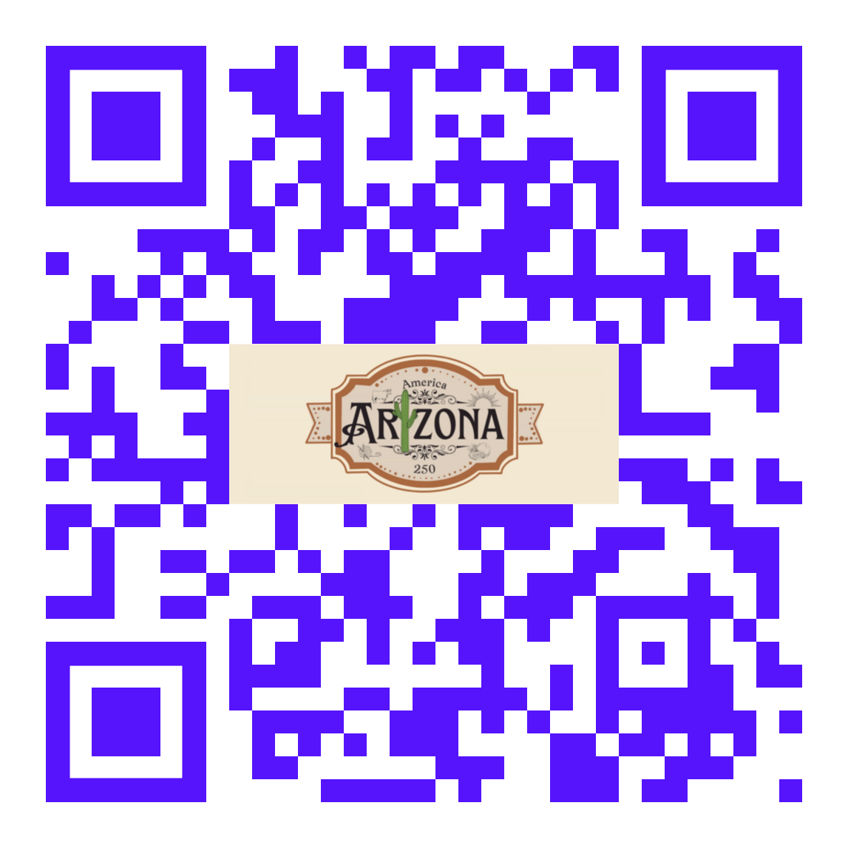
What Your Club Can Do
Assign a Club Champion to organize and promote
Coordinate with community
Identify Club Service Projects
  Especially ones relevant to this event, e.g. town celebrations, 250 activities
  Let D5500 Leadership know
  Enter in Rotary Int’l Service Project Center at MyRotary Service Project Center
Participate in America250 and Arizona America250 Activities
  Traveling Museum
Links:
  America250
  Arizona America250
  MyRotary Service Project Center

Slide 3
Traveling Museum Schedule *Dates and locations subject to change
Arizona America250’s signature initiative, the Road to 250: Arizona Traveling Museum, will see Arizona’s replica Liberty Bell
travel to all 15 counties before returning to the Arizona State Capitol for permanent installation. The museum will feature
engaging, interactive exhibits on American history and Arizona: past, present, and future.
Follow us @america250AZ on Facebook, Instagram, X, and Threads for more information!
February
14 – Prescott Chamber of Commerce, Prescott, AZ
15 – Prescott Chamber of Commerce, Prescott, AZ
16 – Western Park, Parker, AZ
19 – Wickenburg Public Library, Wickenburg, AZ
20 – Glendale Public Library, Glendale, AZ
22 – Frontier Town, Cave Creek, AZ
24 – Yuma Crossing National Heritage Area, Yuma, AZ
27 – Colangelo Museum (GCU Campus), Phoenix, AZ
28 – Red Mountain Library, Mesa, AZ
March
1 – Florence Community Center, Florence, AZ
2 – Dorothy Powell Senior Center, Casa Grande, AZ
5 – Town of Marana, Marana, AZ
6 – City of Nogales, Nogales, AZ
7 – Patagonia Museum, Patagonia, AZ
9 – Fort Lowell, Tucson, AZ
12 – Sierra Vista Public Library, Sierra Vista, AZ
13 – Downtown Tombstone, Tombstone, AZ
March (continued)
15 – City of Wilcox, Wilcox, AZ
16 – Safford City Hall, Safford, AZ
18 – American Legion, Clifton Post 28, Clifton, AZ
20 – Hoopes Activity Center, Thatcher, AZ
22 – Bullion Plaza Cultural Center, Miami, AZ
25 – Ramsey Park, Eagar, AZ
27 – Snowflake–Taylor Public Library, Snowflake, AZ
29 – Navajo Veterans Park, Window Rock, AZ
30 – Navajo Technical University – Chinle Campus, Chinle, AZ
April
2 – Page Public Library, Page, AZ
4 – Fredonia Fire Department, Fredonia, AZ
6 – Flagstaff Visitor Center, Flagstaff, AZ
9 – Bullhead City Community Center, Bullhead City, AZ
11 – Lake Havasu City Library, Lake Havasu City, AZ

